Slide 1
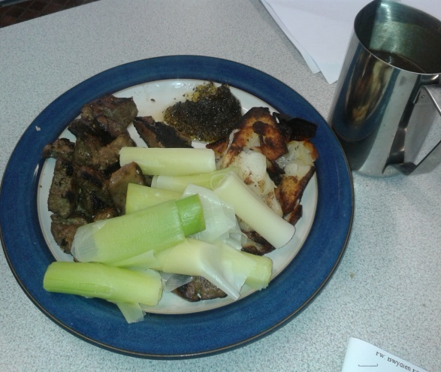
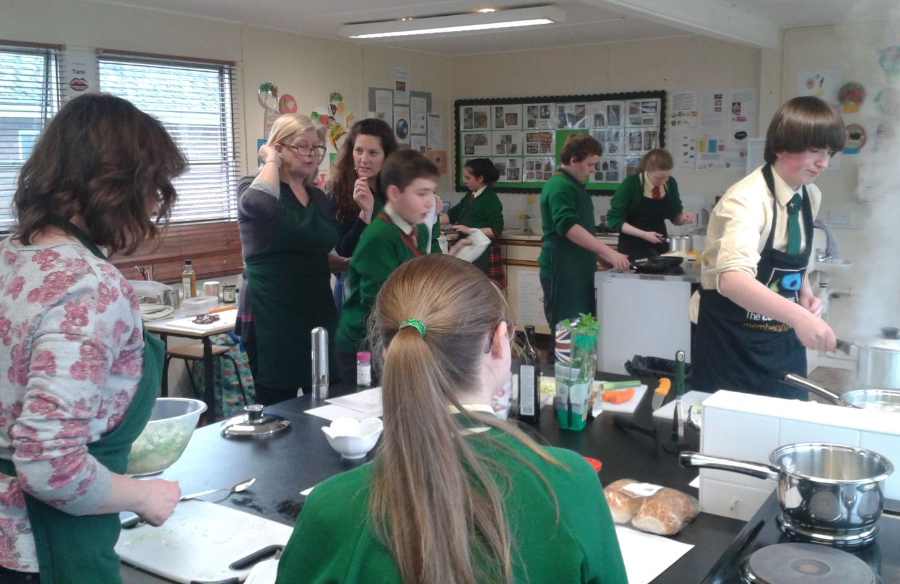
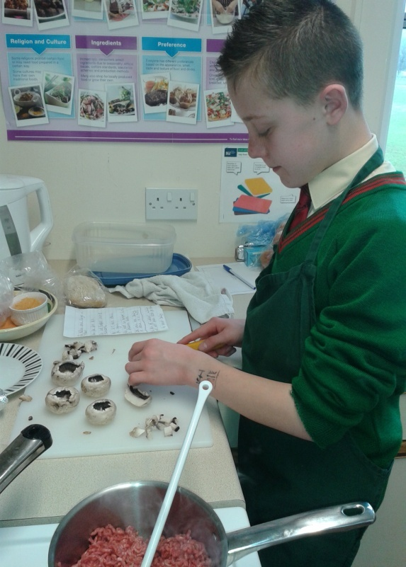
The Denbighshire Menu Competition 2015
10 competitors took place in the round 1 Denbighshire Menu 2015 Competition, making a main course dish from a selection of Welsh based ingredients and using other fresh
fruit and vegetables. Marks were awarded for creative use of ingredients, food preparation and cooking, food hygiene and safety, presentation, taste and texture. The judges Mrs Lawrence and Mrs White found it difficult to decide the winner from dishes such as mint lamb burgers and spaghetti bolognaise. The winners were Cameron Ackroyd ( year 11) with lamb chops and leek and potato mash with a reduced sauce. Second place Freya Jones (year 8) with home made pasta tagliatelle, runners up were Emily Hone (year 10) who made a wonderful leek and potato soup with bacon and onion, and Ben Harmsworth who cooked a meaty dish of lamb heart, liver and bacon with Dauphienois potatoes and leeks. The two round 1 winners will represent St Brigids School in round 2 with other Denbighshire Schools in May, well done to all those who took part.

Slide 2
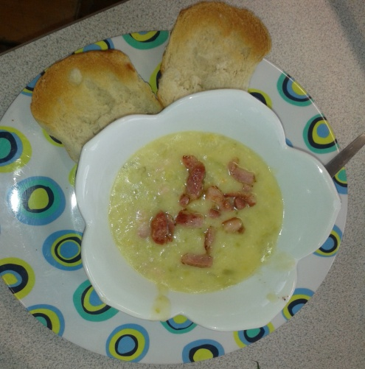
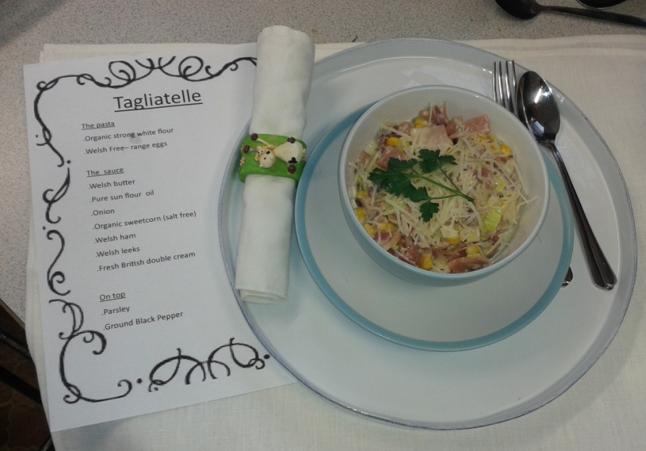
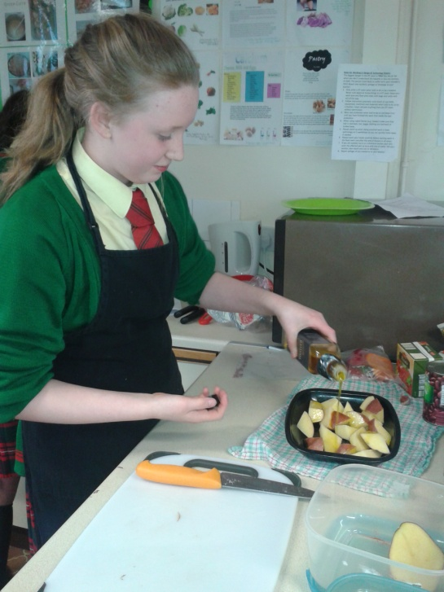
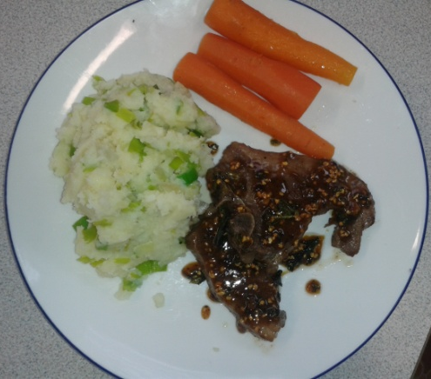
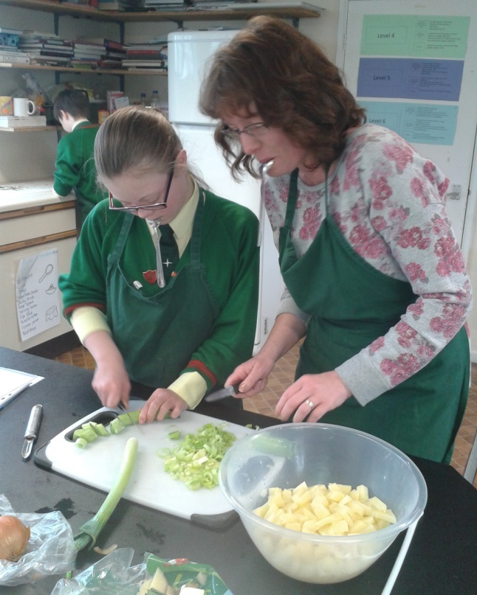
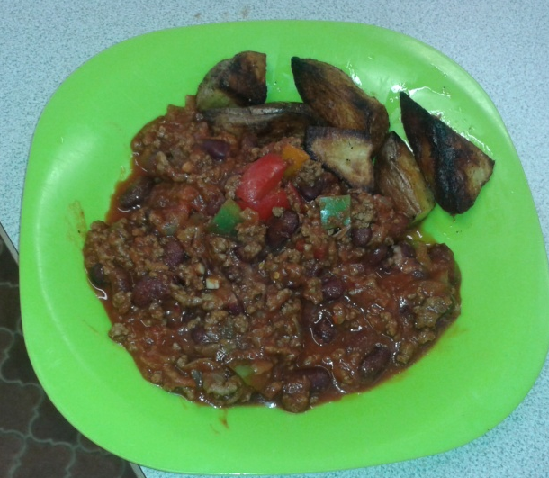
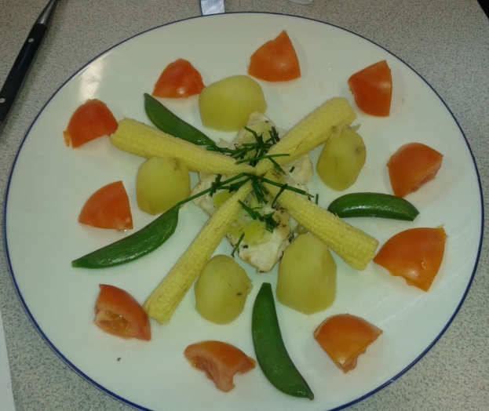

Slide 3
